Slide 1
Fun-A-Holics Project 2: Fun Activities Creation and Participation System - Using GCP (CSE 546 Cloud Computing - Dr. Ming Zhao)
Gunda Akshay Kumar (1217179379)
Kusumakumari Vanteru (1217031218)
Tejaswi Paruchuri (1213268054)

Slide 2
Problem Statement
Fun-A-Holics application effectively utilizes the PAAS services provided by Google Cloud Platform i.e., Google App Engine, Google Cloud Scheduler, Google Cloud SQL to provide hosting and auto-scaling of the application on demand.
This application will provide an interactive Web-Interface to help users find recreational activities (indoor and outdoor) based on criteria such as the number of group members, minimum age/maximum age information, budget, location preferences, category of activities, status of event etc, which are selected by the user.
Technologies Used, We have used the following technologies while developing this application,
Front-end : HTML5, CSS, Bootstrap
Back-end : Python Flask framework
APIs : Google Mail API
Database : MySQL

Slide 3
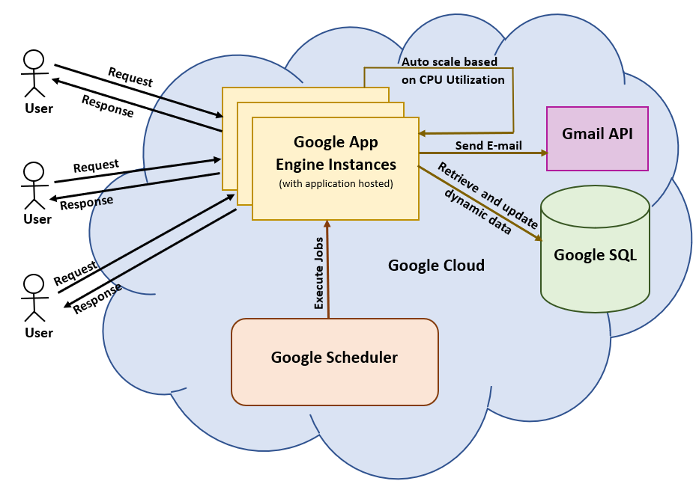
Architecture

Slide 4

Let’s Demo Fun-A-Holics

Slide 5
Thank You

